Slide 1

CSE 423
Virtualization and Cloud Computing
Lecture 17
Module V
Dr. Madhavi Dhingra

Slide 2
Contents
Cloud Risk, Cloud Risk Division
Policy and Organizational Risks, Technical Risks, Legal Risks, Other Risks,
Cloud Computing Security Architecture
VM Security Challenges

Slide 3
Cloud Risk
When Infrastructure, applications, data and storage are hosted by cloud providers, there is a huge chance of risk in each type of service offering – known as Cloud Risk
Several aspects apart from cost and offered services must be evaluated before choosing a particular cloud provider.
Organisations such as Cloud Security Alliance (CSA)offer certification to cloud providers that meet the criteria. The CSA Trusted cloud initiative program was created to help cloud service providers enable industry recommended standards, secure access and follow best practices.

Slide 4
Cloud Risk Division
Cloud Risks are divided into four major categories -
Policy and Organizational Risks
Technical Risks
Legal Risks
Other Risks

Slide 5
Policy and Organizational Risks
1. Lock-in
When applications, data and services are dependent on only one cloud provider, it is known as lock-in problem. There could be SaaS lock in, PaaS lock in and IaaS lock in. Lock in problem occurs because of high customization of services according to user demand.
2. Loss of Governance
The cloud provider may sub-contract or outsource services to third parties that may not compromise the same guarantees as issued by the cloud provider. There is a possibility that the control and operational management of the cloud provider may change and with that terms and conditions of the services may also change. Loss of control and governance could lead to impossibility of fulfilling the security requirements, lack of confidentiality, integrity and availability of data.
3. Compliance Challenges
Cloud providers make huge investments for external certifications such as SAS70, PCI DSS and HIPPA. These certifications give them the reputation in the market that they are following the best security practices.
But in few cases, this might create a problem for accessing cloud services. Like, If a client using AWS cloud want to use EC2 service and if EC2 doesn’t have PCI (Payment card industry) compliance, then EC2 cannot be used for credit card transactions.

Slide 6
Policy and Organizational Risks
3. Cloud service termination or failure –
There must be 24 by 7 support and high availability of all services, but in competitive world of IT, an inadequate business strategy, lack of financial support and other factors could lead some providers to go out of business or shut down their service offering.
4. Supply chain failure –
There is a possibility that the cloud provider could outsource some services to other third parties. In that case, any interruption or corruption in the chain or a lack of coordination of responsibilities between all parties involved can lead to inaccessibility of services, loss of data confidentiality, availability and integrity. It may also lead to economic and reputational losses because of failure to meet customer demand such as cascading service failure and violation of SLA.

Slide 7
Technical Risks
1. Isolation failure -
Because cloud computing works on multi tenancy and shared resources architecture, there is sharing of computing capacity, storage and network among multiple users. This multi tenancy also leads toward some threats such as failure of logical or physical separations between memory stacks and storage where the data of multiple customers can be maliciously stored in the same table.
2. Resource exhaustions -
Cloud service is fully on-demand pay per use service. There is a chance of risk in proper allocation of resources to cloud users. Although there are many resource allocation algorithms used for allocating all the resources of a cloud service, insufficient resource provisioning and investment in infrastructure may lead to service unavailability problem or degradation in performance.
3. Cloud provider malicious insider –
The malicious actions of an insider could possibly have an impact on CIA of all kind of data, services and therefore can affect the reputation of the organization, expectation of the customer and experience of the employees.

Slide 8
Technical Risks
4. Intercepting data in transit-
Cloud Services are based on distributed architecture, therefore transmission of data takes place across different physical machines, VM machines, remote clients and Cloud infrastructure. The risk is more vulnerable when data is being transferred from on premises to cloud or vice versa.
5. Insecure of ineffective deletion of data -
Whenever a provider is altered, resources are scaled down, physical hardware is removed, data may be available beyond the lifetime specified in the security policy. It may be tough to carry out the procedures stated b y the security policy because full data deletion is only imaginable by destroying a disk that also stores data from other clients. When a request to delete a cloud resource is made, this may not result in true wiping of the data. An effective spreading of data and encryption procedure is required to reduce this risk.
6. Conflict between customer hardening procedures and cloud environment –
Cloud providers follow different server or instances hardening mechanisms that are little different from traditional server hardening mechanisms.

Slide 9
Technical Risks
7. Loss of Encryption keys -
This includes disclosure of secret keys or passwords to malicious parties, the loss or corruption of those keys or their unauthorized use for authentication.
8. Malicious Probes or Scams -
Malicious probes or scanning as well as network mapping are indirect threats to the assets being considered. They can be used to collect information in the context of a hacking effort.
9. Compromise Service Engine–
All cloud providers rely either on an extremely specific platform or the service engine that is placed just above the physical hardware and manages customer requests. Hacking the service engine may be useful to escape the isolation between different customer environments and gain access to the data contained inside them.

Slide 10
Legal Risks
1. Risk from changes of jurisdiction -
Customers data may be kept in several jurisdictions, some of which may be high risk. If data centers are located in high risk countries, sites could be attacked by local authorities and data or systems subject to enforced disclosure or seizure.
2. Licensing Risks -
Licensing conditions such as per-seat agreements and online licensing checks may become unusable in a cloud environment for ex. Software is charges at per instances basis, so if our cloud based instances increases, the cost of software also increases exponentially.
3. Data Protection Risks –
It can be tough for a cloud customer (data controller) to ensure that data is handled in a lawful way. There may be data security breaches that are not intimated to the controller by the cloud provider. The issue id increased in case of multiple transfers of data.

Slide 11
Other Risks
1. Backup Lost or Stolen
2. Unauthorized access to premises
3. Theft of computer equipment
4. Natural Disasters

Slide 12
Cloud Computing Security Architecture
There are four layers in the generic architecture of cloud. I.e.. User Layer, Service provider Layer, VM layer and Datacenter Layer.
Datacenter Layer - This layer is related to traditional infrastructure security concerns. It consists of physical hardware security, theft protection, network security and all physical assets security.
VM Layer – This layer involves VM level security issues, VM monitoring, hypervisor-related security issues and VM isolation management issues.
Service Provider Layer – This layer is responsible for identity and access management, service level agreement (SLA), metering, compliance and audit-related issues.
User Layer – This is the first layer of user interaction. It is responsible for user authentication and authorization and all browser related security issues.

Slide 13
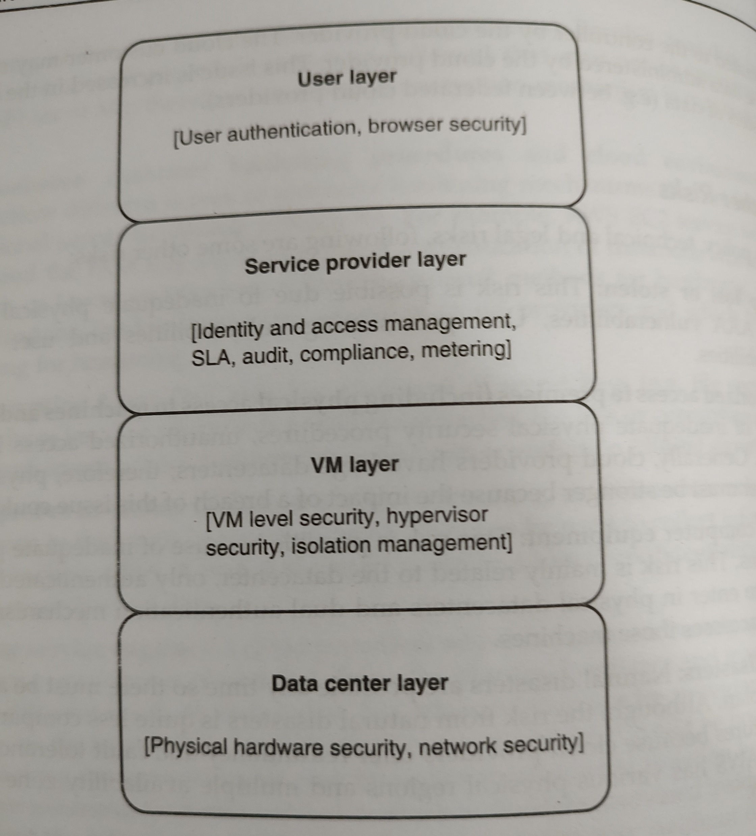

Slide 14
VM Security Challenges
Communication between VMs or between VMs and the host: Sharing physical computer resources, providing general h/w platform are the key requirements for any organization. The OS enables the VM layer for logging in to all guest VMs. Since VM technology provides full access to all guest VMs thus a strong layer of security and isolation must be there between guests and the host VM.
VM Escape: In ana ideal situation, any program that runs under the VM should not communicate to any other program inside that or any other VM. But It may so happen that a program running inside a VM can totally bypass the VM layer and acquire full access to the host system. Such situation is called as VM escape.
VM monitoring from the host: It is not normally considered as a limitation or bug when one can start monitoring, changing or communicating with a VM application. In this case, the host itself starts controlling; therefore host requires more strict security environments compared to each individual VMs.
VM Monitoring from another VM: Isolation is a basic feature of VM technology; it is a security defect when one VM can easily monitor another without definite configurations and privilege to do so. Spoofing attacks can occur easily when there is a dedicated network for connecting VMs host machine.

Slide 15
VM Security Challenges
Denial of Service: Because various computing resources like CPU, memory, network and hard disk are shared among multiple VMs, this may create DoS attack against another VM. This can be avoided by limiting the access of VM resources.
External modification of a VM: In a business application, users VMs have the privilege of accessing employee databases through a secured application. Database security is more critical in a virtual environment. If a VM where database is installed becomes accessible from outside because of any attack, then database can be corrupted or modified and system trust can be broken.
External modification of the hypervisor: Hypervisor is mainly responsible for enabling the virtualization ,while making the process of secure VM it does not affect the working of underlying hypervisor. Therefore the first thing is to protect the hypervisor from any external changes.
Resource contention: Whenever some resource consuming operations like malware or anti-virus scanning are executed on VMs, the results of these operations produce high loads on the systems and hamper the server applications and Virtual environments.

